Slide 1
Loop
quyennv

Slide 2
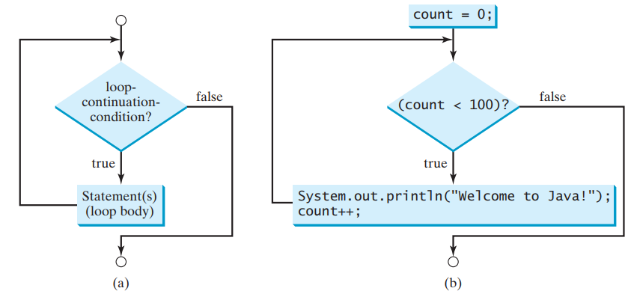
While Loop

Slide 3
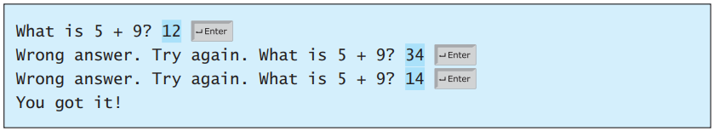
While Loop
int number1 = (int)(Math.random() * 10);
int number2 = (int)(Math.random() * 10);
// Create a Scanner
Scanner input = new Scanner(System.in);
System.out.print("What is " + number1 + " + " + number2 + "? ");
int answer = input.nextInt();
while (number1 + number2 != answer) {
System.out.print("Wrong answer. Try again. What is “ + number1 + " + " + number2 + "? ");
answer = input.nextInt(); }
System.out.println("You got it!");

Slide 4
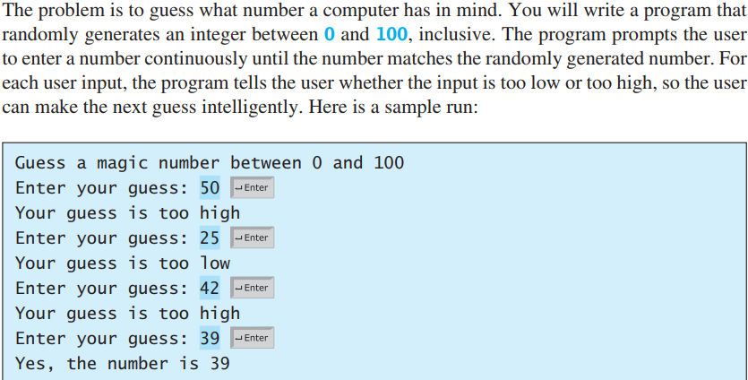
Case study: Guess number

Slide 5
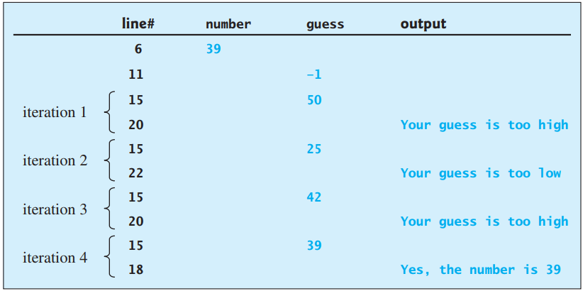
Case study: Guess number II

Slide 6
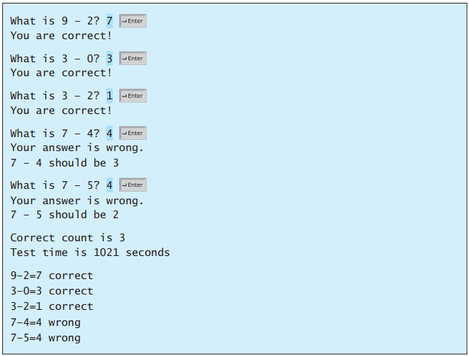
Case study: Multiple Subtraction Quiz
Notes:
package firstdemo;
import java.util.Scanner;
public class Main {
public static void main(String[] args) {
final int NUMBER_OF_QUESTIONS = 5; // Number of questions
int correctCount = 0; // Count the number of correct answers
int count = 0; // Count the number of questions
long startTime = System.currentTimeMillis();
String output = " "; // output string is initially empty
Scanner input = new Scanner(System.in);
while (count < NUMBER_OF_QUESTIONS) {
// 1. Generate two random single-digit integers
int number1 = (int) (Math.random() * 10);
int number2 = (int) (Math.random() * 10);
// 2. If number1 < number2, swap number1 with number2
if (number1 < number2) {
int temp = number1;
number1 = number2;
number2 = temp;
}
// 3. Prompt the student to answer "What is number1 – number2?"
System.out.print("What is " + number1 + " - " + number2 + "? ");
int answer = input.nextInt();
// 4. Grade the answer and display the result
if (number1 - number2 == answer) {
System.out.println("You are correct!");
correctCount++; // Increase the correct answer count
} else
System.out.println(
"Your answer is wrong.\n" + number1 + " - " + number2 + " should be " + (number1 - number2));
// Increase the question count
count++;
output += "\n" + number1 + "-" + number2 + "=" + answer
+ ((number1 - number2 == answer) ? " correct" : " wrong");
}
long endTime = System.currentTimeMillis();
long testTime = endTime - startTime;
System.out.println(
"Correct count is " + correctCount + "\nTest time is " + testTime / 1000 + " seconds\n" + output);
}
}

Slide 7
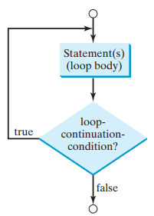
Do-while loop
The do-while loop executes the loop body first, then checks the loopcontinuation-condition to determine whether to continue or terminate the loop.
Loop terminates. The difference between a while loop and a do-while loop is the order in which the loop-continuation-condition is evaluated and the loop body executed. You can write a loop using either the while loop or the do-while loop. Sometimes one is a more convenient choice than the other.

Slide 8
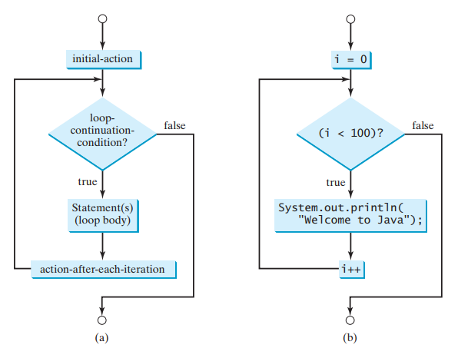
For loop

Slide 9
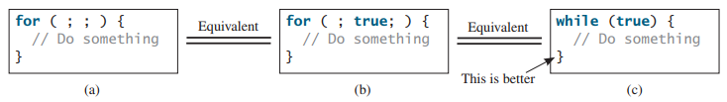
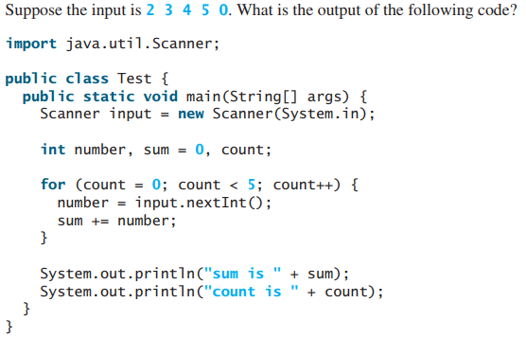
For loop

Slide 10
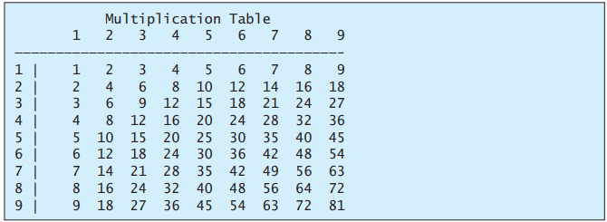
Nested loop

Slide 11
Case study: Dec to Hex
Hexadecimals are often used in computer systems programming (see Appendix F for an introduction to number systems). How do you convert a decimal number to a hexadecimal number? To convert a decimal number d to a hexadecimal number is to find the hexadecimal digits hn, hn - 1, hn - 2, c , h2, h1, and h0 such that d = hn * 16^n + h(n – 1) * 16^(n – 1) + h(n – 2) * 16^(n – 2) + … + h2 * 16^2 + h1 * 16^1 + h0 * 16^0
These hexadecimal digits can be found by successively dividing d by 16 until the quotient is 0. The remainders are h0, h1, h2, c , hn - 2, hn - 1, and hn. The hexadecimal digits include the decimal digits 0, 1, 2, 3, 4, 5, 6, 7, 8, and 9, plus A, which is the decimal value 10; B, which is the decimal value 11; C, which is 12; D, which is 13; E, which is 14; and F, which is 15.
For example, the decimal number 123 is 7B in hexadecimal. The conversion is done as follows. Divide 123 by 16. The remainder is 11 (B in hexadecimal) and the quotient is 7. Continue divide 7 by 16. The remainder is 7 and the quotient is 0. Therefore 7B is the hexadecimal number for 123.

Slide 12
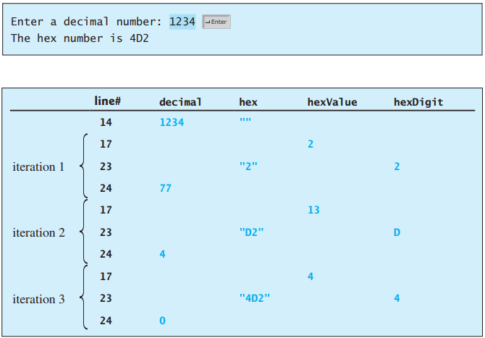
Case study: Dec to Hex
Notes:
while (decimal != 0) { int hexValue = decimal % 16; // Convert a decimal value to a hex digit char hexDigit = (hexValue <= 9 && hexValue >= 0) ? (char)(hexValue + '0') : (char)(hexValue - 10 + 'A'); hex = hexDigit + hex; decimal = decimal / 16; }

Slide 13
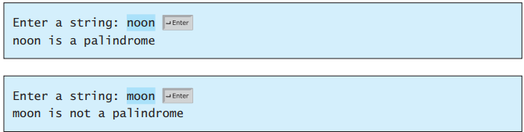
Case study: Palindrome
A string is a palindrome if it reads the same forward and backward. The words “mom,” “dad,” and “noon,” for instance, are all palindromes.
The problem is to write a program that prompts the user to enter a string and reports whether the string is a palindrome. One solution is to check whether the first character in the string is the same as the last character. If so, check whether the second character is the same as the second-to-last character. This process continues until a mismatch is found or all the characters in the string are checked, except for the middle character if the string has an odd number of characters.

Slide 14
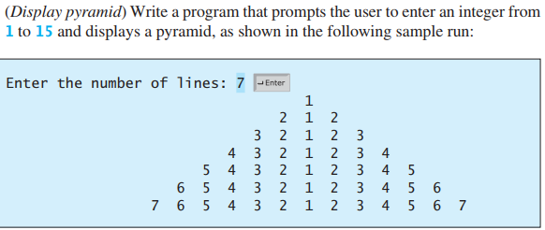
Exercise I

Slide 15
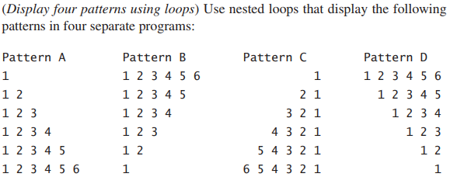
Exercise II
Notes:
Pattern A && C
package firstdemo;
import java.util.Scanner;
public class Main {
public static void main(String[] args) {
Scanner input = new Scanner(System.in);
System.out.println("Enter number of rows: ");
int noOfRows = input.nextInt();
int rowCount = 1;
System.out.println();
for (int i = noOfRows; i > 0; i--)
{
for (int j = 1; j <= i*2; j++)
{
System.out.print(" ");
}
for (int j = 1; j <= rowCount; j++)
{
System.out.print(j+" ");
}
for (int j = rowCount-1; j >= 1; j--)
{
System.out.print(j+" ");
}
System.out.println();
rowCount++;
}
}
}
Pattern B && D
package firstdemo;
import java.util.Scanner;
public class Main {
public static void main(String[] args) {
Scanner input = new Scanner(System.in);
System.out.println("Enter number of rows: ");
int noOfRows = input.nextInt();
int rowCount = noOfRows;
System.out.println();
for (int i = 0; i < noOfRows; i++) {
// Printing i*2 spaces at the beginning of each row
for (int j = 1; j <= i * 2; j++) {
System.out.print(" ");
}
// Printing j where j value will be from 1 to rowCount
for (int j = 1; j <= rowCount; j++) {
System.out.print(j + " ");
}
// Printing j where j value will be from rowCount-1 to 1
for (int j = rowCount - 1; j >= 1; j--) {
System.out.print(j + " ");
}
System.out.println();
// Decrementing the rowCount
rowCount--;
}
}
}

Slide 16
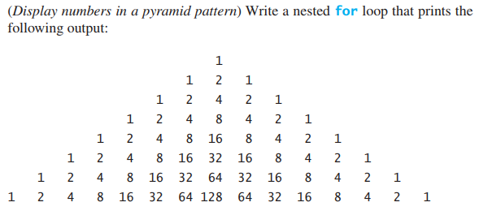
Exercise III
Notes:
package firstdemo;
import java.util.Scanner;
public class Main {
public static void main(String[] args) {
//Scanner input = new Scanner(System.in);
// System.out.println("Enter number of rows: ");
int noOfRows = 8;
int rowCount = 1; // count row
for (int i = noOfRows; i > 0; i--){
// In gấp đôi khoảng trắng ở phần đầu
for (int j = 1; j <= i*2; j++){
System.out.print(" ");
}
// sau đó in các số từ 1 cho đến số lớn nhất (theo số dòng nên chính là số dòng)
for (int j = 1; j <= rowCount; j++){
System.out.printf("%4d",(int)Math.pow(2, j-1));
}
// In ngược lại so với bước trên
for (int j = rowCount-1; j >= 1; j--){
System.out.printf("%4d",(int)Math.pow(2, j-1));
}
// xuống dòng
System.out.println();
// dòng tiếp theo
rowCount++;
}
}
}

Slide 17
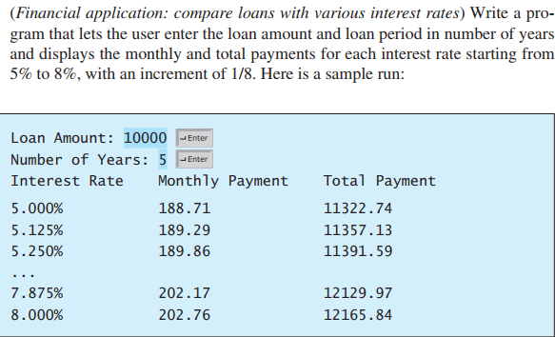
Exercise IV

Slide 18
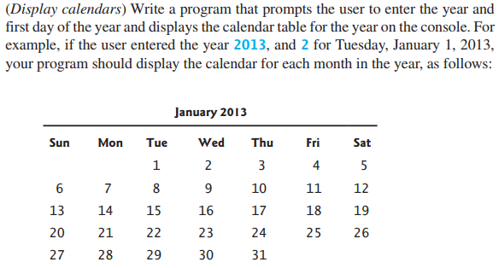
Exercise V
Notes:
package firstdemo;
import java.util.Scanner;
public class Main {
public static void main(String[] args) {
Scanner input = new Scanner(System.in);
System.out.print("Enter a year: ");
int year = input.nextInt();
System.out.print("Enter the first day of the year: ");
int startDay = input.nextInt();
int numberOfDaysInMonth = 0;
for (int month = 1; month <= 12; month++)
{
System.out.print(" ");
switch (month)
{
case 1:
System.out.println("January " + year);
numberOfDaysInMonth = 31;
break;
case 2:
System.out.println("February " + year);
if ((year % 400 == 0) || ((year % 4 == 0) && (year % 100 != 0))) {
numberOfDaysInMonth = 29;
} else {
numberOfDaysInMonth = 28;
}
break;
case 3:
System.out.println("March " + year);
numberOfDaysInMonth = 31;
break;
case 4:
System.out.println("April " + year);
numberOfDaysInMonth = 30;
break;
case 5:
System.out.println("May " + year);
numberOfDaysInMonth = 31;
break;
case 6:
System.out.println("June " + year);
numberOfDaysInMonth = 30;
break;
case 7:
System.out.println("July " + year);
numberOfDaysInMonth = 31;
break;
case 8:
System.out.println("August " + year);
numberOfDaysInMonth = 31;
break;
case 9:
System.out.println("September " + year);
numberOfDaysInMonth = 30;
break;
case 10:
System.out.println("October " + year);
numberOfDaysInMonth = 31;
break;
case 11:
System.out.println("November " + year);
numberOfDaysInMonth = 30;
break;
case 12:
System.out.println("December " + year);
numberOfDaysInMonth = 31;
}
System.out.println("-----------------------------");
System.out.println(" Sun Mon Tue Wed Thu Fri Sat");
for (int i = 0; i < startDay; i++) {
System.out.printf("%4s"," ");
}
for (int i = 1; i <= numberOfDaysInMonth; i++)
{
if (i < 10) {
System.out.printf("%4d",i);
} else {
System.out.printf("%4d",i);
}
if ((i + startDay) % 7 == 0) {
System.out.println();
}
}
System.out.println();
startDay = (startDay + numberOfDaysInMonth) % 7;
}
}
}

Slide 19
Exercise VI - VIII
VI. (Perfect number) A positive integer is called a perfect number if it is equal to the sum of all of its positive divisors, excluding itself. For example, 6 is the first perfect number because 6 = 3 + 2 + 1. The next is 28 = 14 + 7 + 4 + 2 + 1. There are four perfect numbers less than 10,000. Write a program to find all these four numbers.
VII. (Display prime numbers between 2 and 1,000) A program to display all the prime numbers between 2 and 1,000, inclusive. Display eight prime numbers per line. Numbers are separated by exactly one space.
VIII. (Reverse a string) Write a program that prompts the user to enter a string and displays the string in reverse order. (do not use any built-in function)
For example,
Enter a string: ABCD (Enter)
The reversed string is DCBA

Slide 20
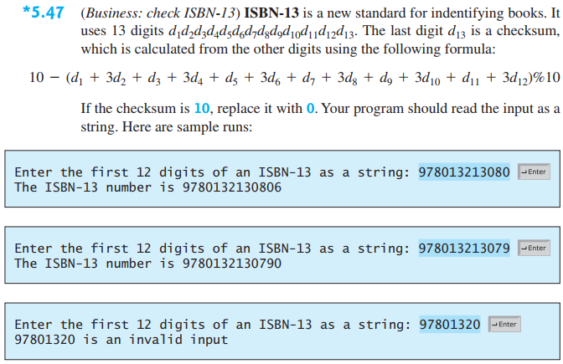
Exercise IX

Slide 21
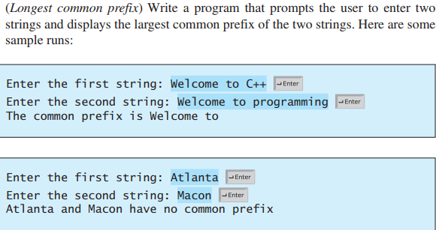
Exercise X

